Slide 1

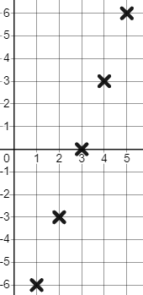

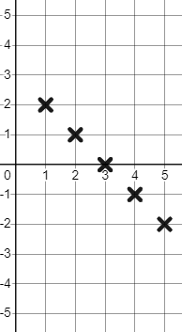

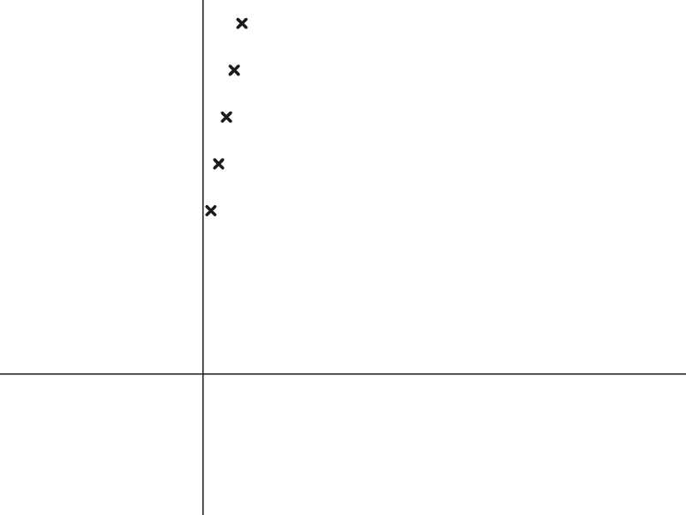

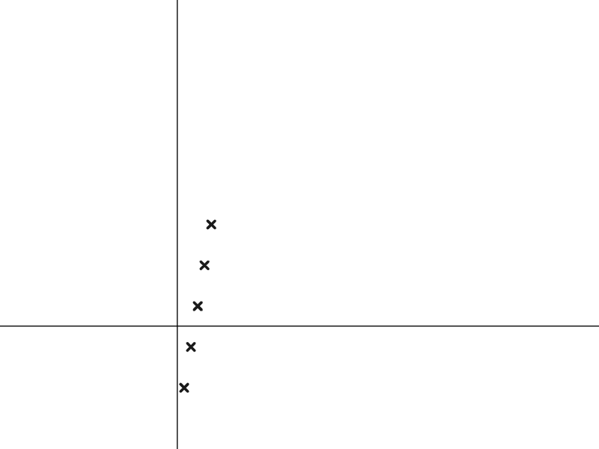

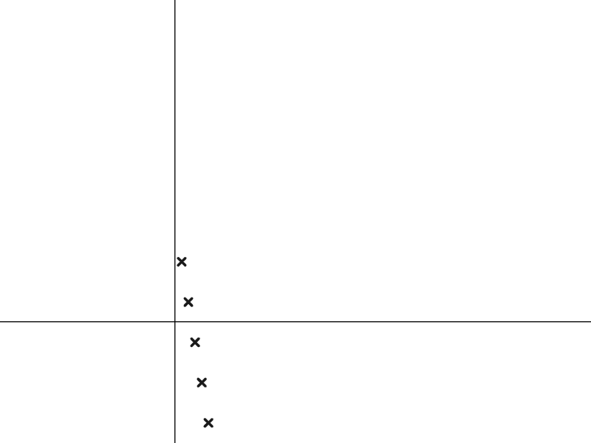
Representing sequences graphically
Task A: Plotting arithmetic sequences
1) Find and plot the first five terms of these arithmetic sequences.
a)
Term number (n) | 1 | 2 | 3 | 4 | 5
Term value (T) | -6 | -3 | 0 | 3 | 6
Term value
Term number
b)
Term value
Term number (n) | 1 | 2 | 3 | 4 | 5
Term value (T) | 2 | 1 | 0 | -1 | -2
Term number
2) Match the sequences to their graph.
Increasing sequence with all positive term values.
Increasing sequence with some negative term values.
Decreasing sequence.

Slide 2
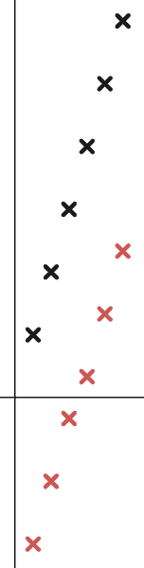

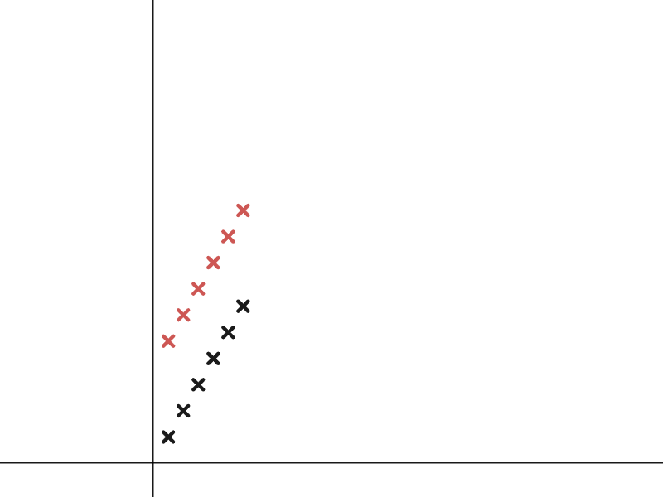
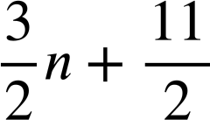



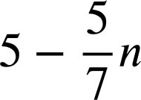
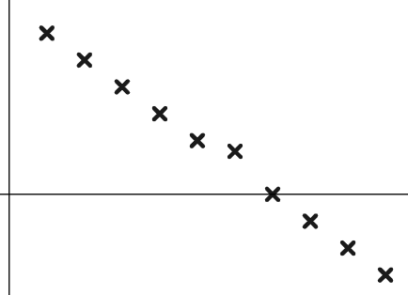

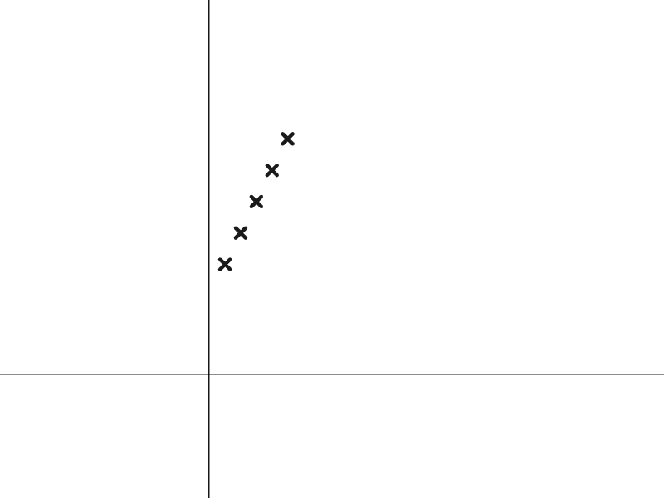



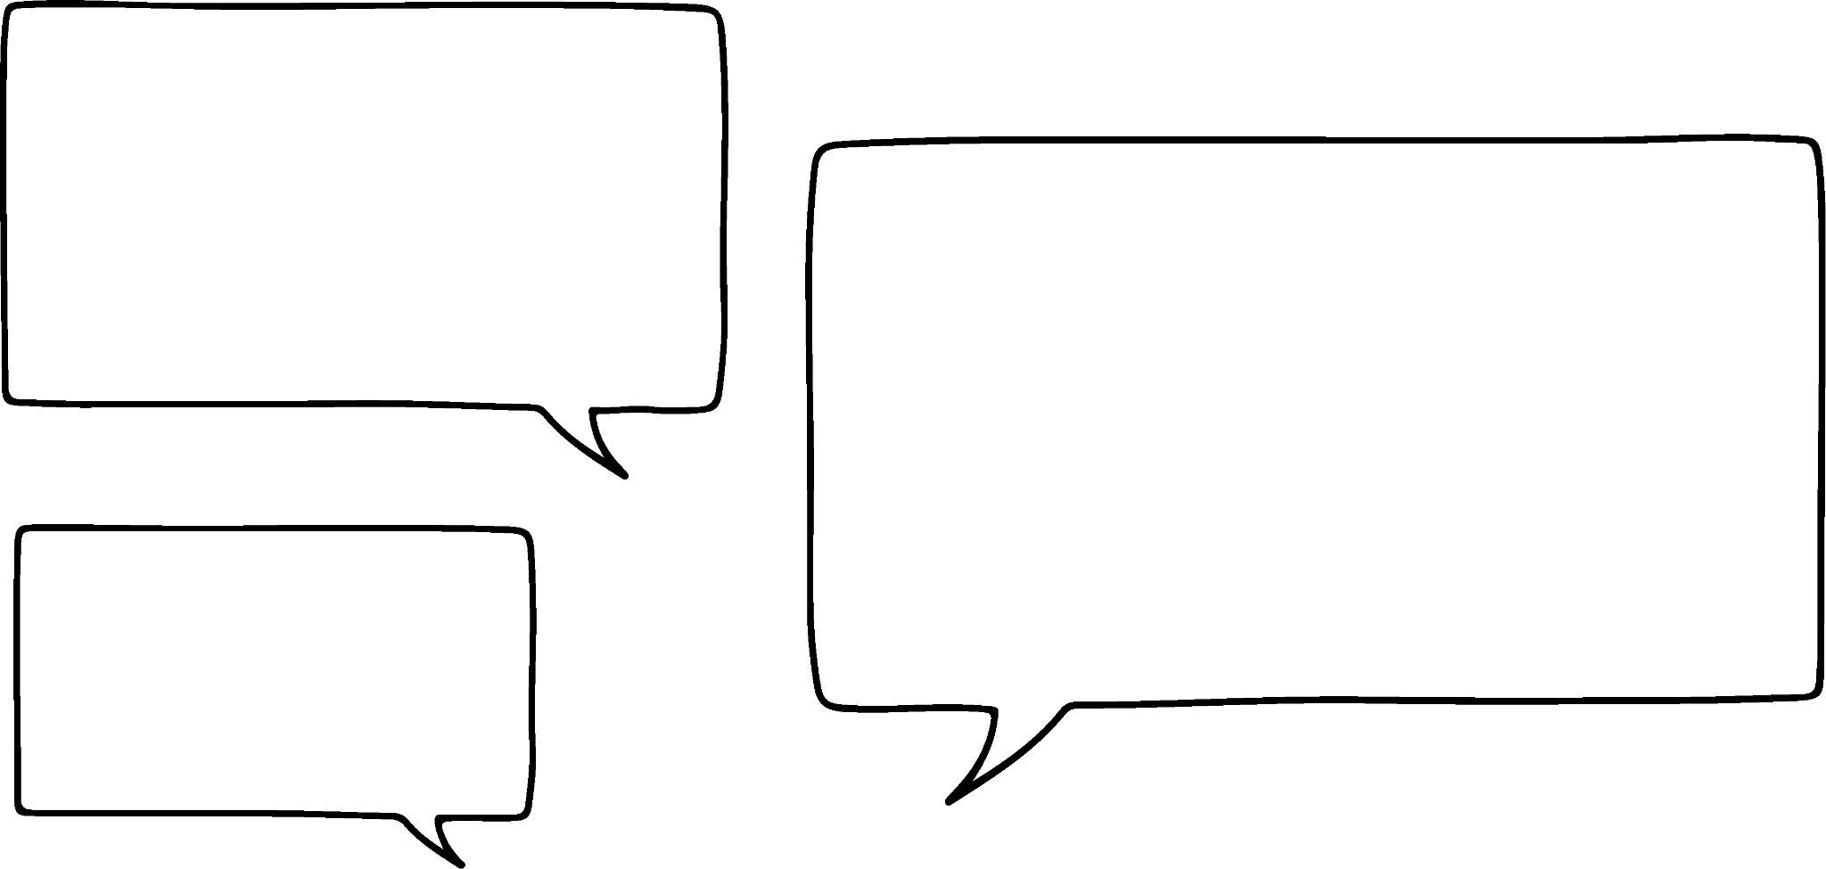

Representing sequences graphically
Task B: Features of sequences represented graphically
1) a) Match these arithmetic sequences to the correct plotting.
b) Write a few sentences explaining how you identified each sequence.
You might have written:
The sequences 3n and 3n − 10 have the same increases term-to-term, with 3n − 10 being a translation of 3n by 10 in the negative vertical direction.
has the same term-to-term increase as but, is a translation by in the positive vertical direction.
2) Izzy has plotted the sequence
Term value
Which term number is wrong? Write a sentence to justify your answer.
Term number
The 6th term number is wrong.
is an arithmetic sequence. The points should align and the 6th one is not in line.
3) a) Sofia has started to draw the structure of the arithmetic sequence 2n + 5
Finish her diagram for her.
b) Write a sentence explaining why this structure represents the sequence 2n + 5
You might have written, the 5 remains constant whereas 2n is a variable, varying the number of 2’s.
Term value
Term number
4) The 10th term of the arithmetic sequence 3.5n is 35 and the 20th term is 70 so Laura says…
I know the 10th term of the arithmetic sequence 3.5n − 21 is 14 so the 20th term must be double that. It’s 28
Explain to Laura why this does work for the arithmetic sequence 3.5n but it doesn’t for the sequence 3.5n − 21
You might have said, the sequence 3.5n has no constant so it is just twice as many variables, whereas 3.5n − 21 contains a constant and that constant will not double.
Mathematics in Education and Industry
v2.2

